Slide 1
Digital Marketing Management
Presented by (Team 10):
Madhumitha.M – BA1-55
Soorya – BA1-57
Christopher Yogesh – BA1-38
Mohamed Yousuf Gani – BA1-40
Raja – BA1-28

Slide 2
Agenda
Introduction
What is Digital Marketing Management?
Project Overview
Key Features
User Flow
Conclusion

Slide 3
Introduction
To develop a console-based eCommerce application that enhances the understanding and implementation of digital marketing strategies.
Aimed at enhancing user experience and providing a streamlined shopping process.
Technology Used: Java for console-based application development.

Slide 4
What is Digital Marketing Management?
Digital marketing management involves using online channels and tools to manage and analyze marketing campaigns, customer interactions, and business sales.
Importance:
Enhances customer reach and engagement.
Provides data-driven insights for better decision-making.
Improves sales through targeted marketing efforts.

Slide 5
Project Overview
This Console-Based eCommerce Application which simulates a simple market shopping experience, allowing users to interact with the application through a command-line interface.

Slide 6
Key Features
Product Categories
Fruits
Vegetables
Cosmetics
Masala Powders
User Interaction
View the list of available items.
Select products by entering the product code.
Specify the required quantity.
Billing and Discounts
Calculate total price based on quantity.
Apply discounts if purchase amount exceeds a certain threshold.
Display the final bill and customer details.

Slide 7
User Flow
Menu Display:
Presents categories and prompts user input.
Product Selection:
Lists products with codes and prices.
Confirms the user's choice.
Quantity and Billing:
Prompts for quantity.
Calculates total price and applies discounts.
Displays final bill and customer details.

Slide 8
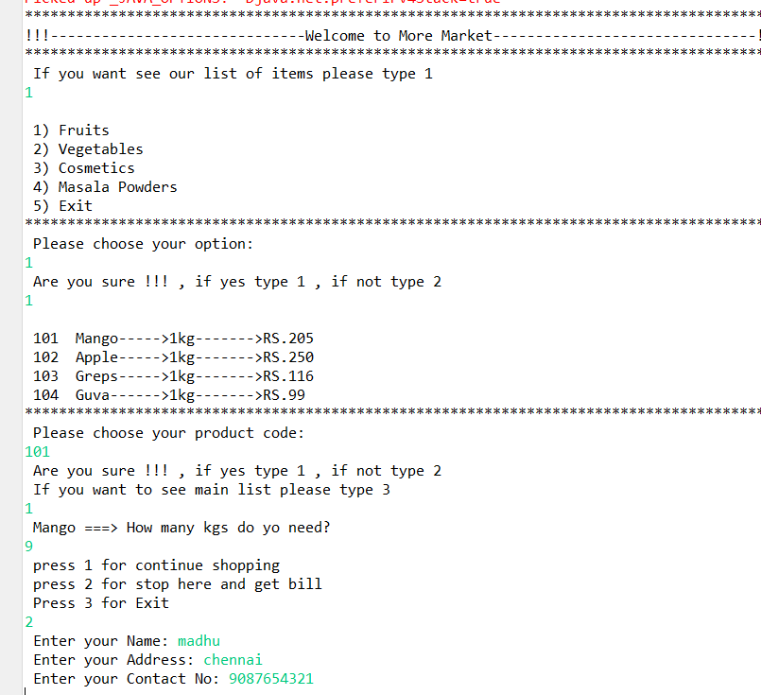
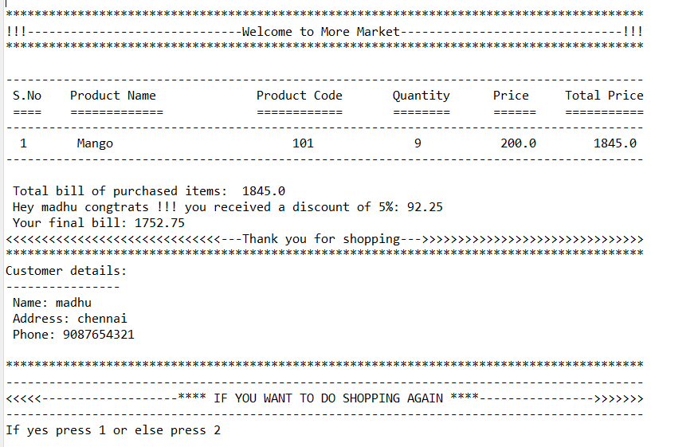
Output

Slide 9
Conclusion
Provides a practical example of a simple eCommerce application.
Demonstrates key aspects of digital marketing management such as customer interaction, product selection, and billing.
Enhances understanding of how digital tools can streamline business processes.
Future Work:
Extend the application with more product categories.
Implement a graphical user interface (GUI) for better user experience.
Integrate more advanced digital marketing features like customer feedback, recommendations, and loyalty programs.

Slide 10
Thank you

